Slide 1
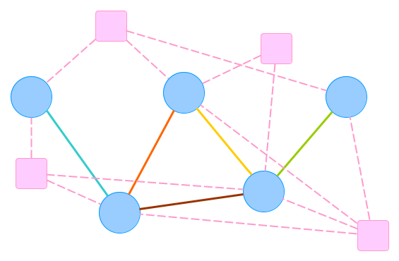
S1
S3
S1,S2
S1,S3,S4
S1,S4
S2
S2,S3,S4
S2,S4
S4

Slide 2
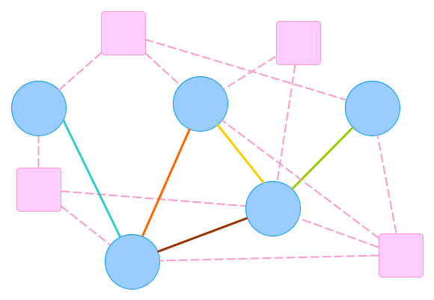
S1
S3
S1 S2
S1 S3 S4
S1 S4
S2
S2 S3 S4
S2 S4
S4

Slide 3
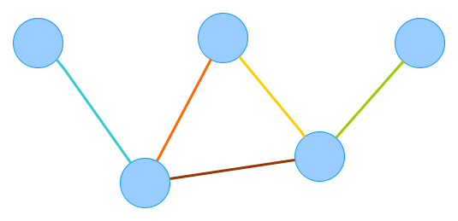
S1,S2
S1,S3,S4
S1,S4
S2,S3,S4
S2,S4

Slide 4
S1,S2
S1 S3 S4
S1 S4
S2 S3 S4
S2 S4

Slide 5
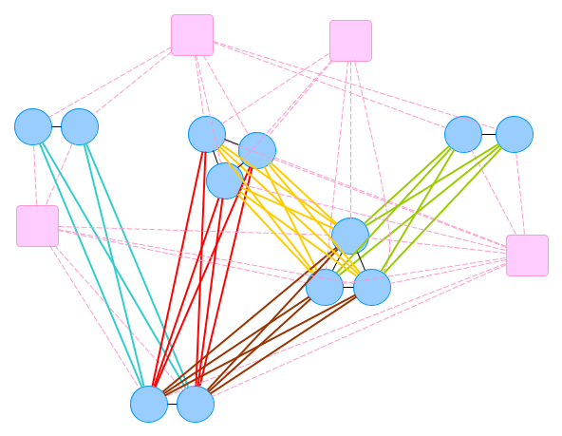
S1
S3
S1
S2
S1
S1
S4
S3
S4
S2
S3
S4
S2
S4
S4
S2
S4

Slide 6
S1
S3
S1
S2
S1
S1
S4
S3
S4
S2
S3
S4
S4
S2
S4
S2
S4

